Slide 1

Gen AI-based Data Profiling
Team : Interstellar Agents

Slide 2
High-Level Overall Plan
Input
Rules and Regulation documents, drafts, CSVs, data dump
Risk Evaluation Logic
Process
Data Extraction
Data Summarization
Logic Processing
CDR Profiling
API Creation
Output
Flag Anomaly
Anomaly Detection Tags
Observation
Interactive Compliance Assistance Portal

Slide 3

Process Flow Mechanism
PDF Files to Matrices
Rule Processing and Enrichment
Data Storage (in-Memory)
Load Historical data and handle missing values
Logical Program to evaluate new transaction records based historical data and rules
Create an interactive compliance assistant and combine rule and ML prediction
Test with new transactions
Invoke Logical Program API from ICA to determine transaction dynamics

Slide 4

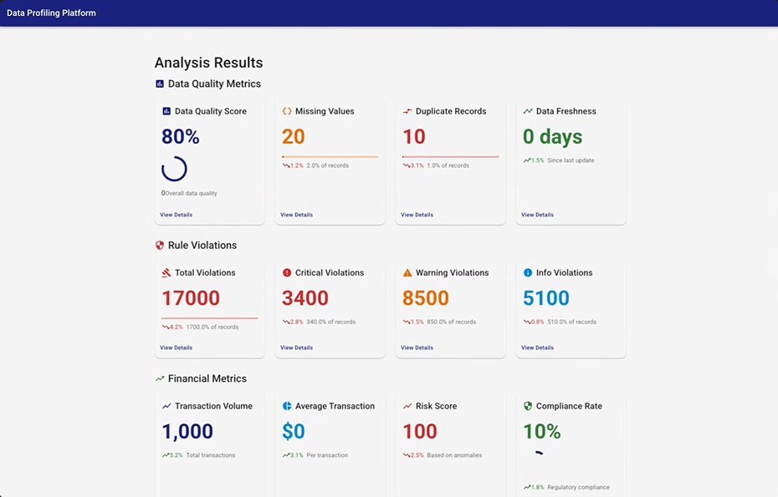












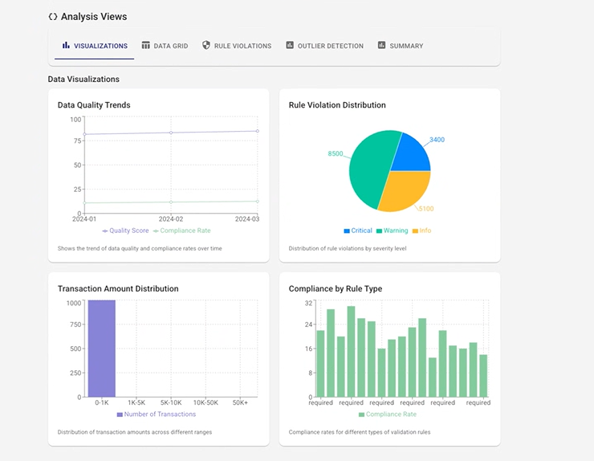
Architectural View
Integration API
Final Results
Interactive Compliance Assistance Portal
In-Memory Rules
Historical data
csv/text File for Rules
Refined Rules Matrix
Logical code
Tech Stack
Process
Data Ingestion
Rules Extraction and Refinement
Logical Application
UI based Transaction analysis
Overall Results
Current: Manual Rule Extraction to CSV/text File
Future: File Parser to Text
Current: Using OpenAI and Python to refine rules
Future: Completely through LLM
Current: Rules(in-Memory), File based Historical data repository and python script based Anomaly detection
Future: Convert in-memory and file based storage to DB
Current: Python and Node Js based interactive Portal
Future: Unified portal for Rules Training, Updates, and transaction analysis
Current: Valid data for few matrices and for others WIP
Future: Robust analysis for all metrices
Arch Specs

Slide 5
Future Solution Process
Extract Banking Rules (PDF → Structured Format)
Preprocess Historical Transactions (Feature Engineering)
Train Risk Detection Model (ML + Rule-Based)
Optimize & Evaluate (Hyperparameter Tuning, Feature Selection)
Deploy Risk Scoring API (FastAPI, Flask)
Continuously Retrain with New Data

Slide 6

Thank You

